Slide 1
Biodiversity

Slide 2
By the end of this lesson, you should be able to:
• | Describe the difference between species diversity and genetic diversity.
• | Describe the relationship between biodiversity and ecosystems.
• | Explain how genetic drift, natural selection and gene flow can change the genetic diversity of a population.

Slide 3
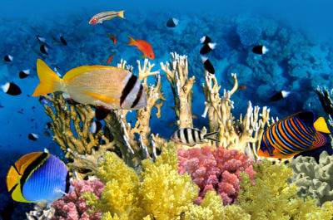
Biodiversity is short for biological diversity.
It is the sum of all living organisms - plants, animals and micro-organisms - and all their genetic variation within complex ecosystems.
Biodiversity can be found everywhere: lakes, forests, oceans, mountains, deserts, housing, parks, to give a few examples. It can even be found on our skin and within internal organs!

Slide 4
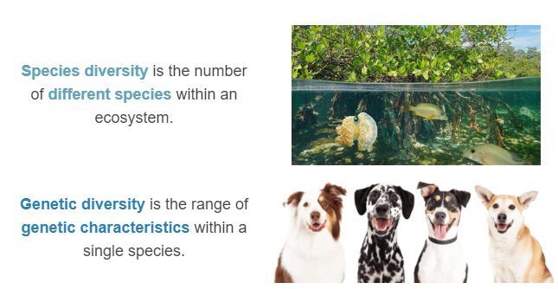
When it comes to biodiversity, there is an important distinction to make.

Slide 5
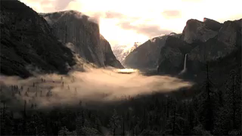
Intact ecosystems also provide a range of services that we rely on.
Soil fertility, pollination and the purification of air and water are just three examples.
Developing technology to replace these services would cost billions of dollars!

Slide 6
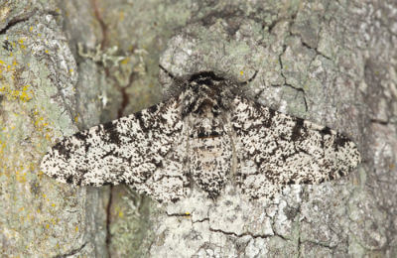
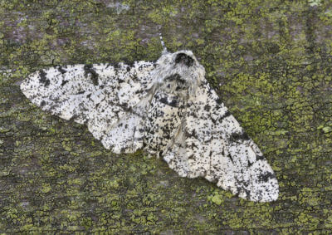
Genetic diversity is the most important in terms of evolution.
If there is genetic diversity or a large number of variations of the same gene (alleles), there will be a large variety of phenotypes (physical characteristics).
Certain phenotypes might be advantageous for a particular environment, giving the individual an increased chance of survival.

Slide 7
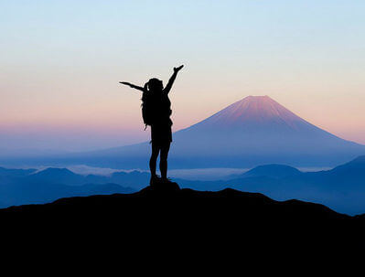
If an individual has a greater chance of survival, it will be more likely to go on to reproduce.
The offspring will be more likely to inherit the advantageous gene, giving them an increased chance of survival too.
As the gene becomes more common in the population, the whole species becomes more successful.

Slide 8
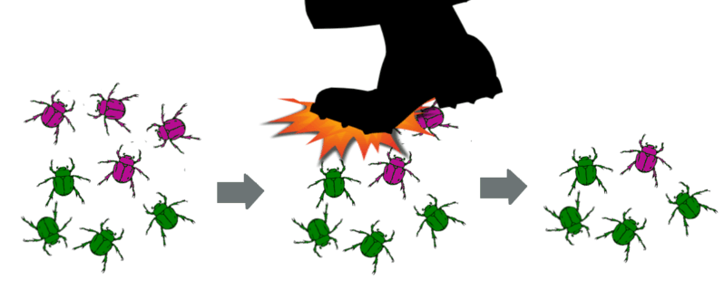
Genetic drift, natural selection and gene flow are three ways of altering allele frequencies, and therefore increasing the genetic diversity within a population of a species.
Genetic drift is an increase or decrease in allele frequency due to a chance event.
For example: a giant foot kills a proportion of purple beetles, reducing the frequency of the purple allele in the gene pool.

Slide 9
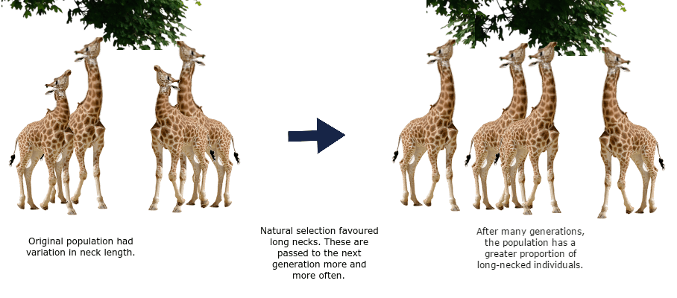
Natural selection is the increase or decrease in the frequency of certain alleles within a population due to environmental pressures.

Slide 10
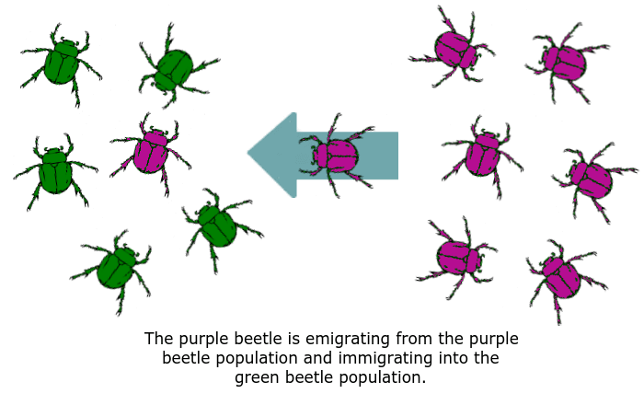
Gene flow (organisms leaving or joining a population) can remove or add alleles to the gene pools of populations.
This can include immigration and emigration.

Slide 11
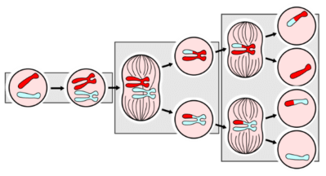
Genetic diversity can also arise between individuals.
This can happen when chromosomes get shuffled and crossed over during meiosis, and through the independent assortment of chromosomes into gametes.
As you can see in the final step of the image above, independent assortment of the chromosomes into the gametes also increases variation as the chromosome in each gamete is different from the others.
The combination of gametes that fuse together during fertilisation provides an additional source of variation.

Slide 12
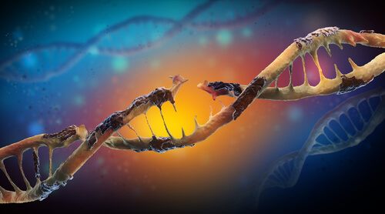
Mutations are another source of genetic diversity. Mutations are changes in an organism's genetic code, or DNA.
Sometimes, mutations can cause changes in an organism's phenotype. In fact, mutations that occur in gametes (egg or sperm cells) are the sole source of new alleles.

Slide 13
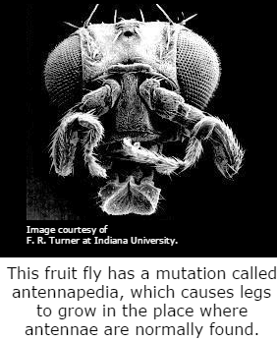
In much the same way as other alleles, mutations that are beneficial will be selected for.
Organisms that have them will be more likely to survive, reproduce and pass these mutations on to the next generation.
Mutations may also be harmful. These will be selected against, as the organism is more likely to die before it gets a chance to reproduce.

